Slide 1
API and Python training
Session 4

Slide 2
This session agenda
Import packages
Python requests library
Making API requests
Practice
JSON
Recap from last session – nested data structures
Accessing JSON data
Practice

Slide 3
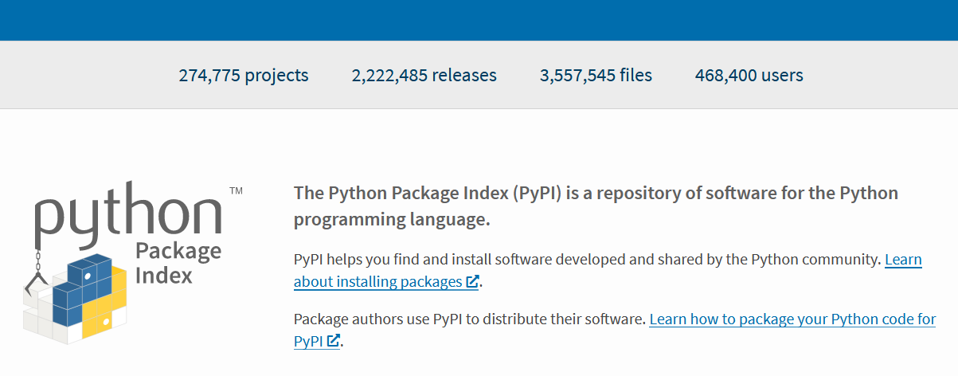
Installing and importing modules
Python module is just a normal Python file with .py
You can split your code into modules to make it easier to understand and maintain
Packages are set of modules, like folders
Modules can be written on other languages and can be publically available, often called libraries
Packages can use other packages, called dependencies
Some packages already comes with Python, they are called standard libraries, you don’t have to install them
Downloaded from package repository https://pypi.org/ or its mirrors using pip utility, next slide
Once the package is installed
use import statement in the code
https://stackoverflow.com/questions/19198166/whats-the-difference-between-a-module-and-a-library-in-python
https://realpython.com/python-import/#basic-python-import

Slide 4
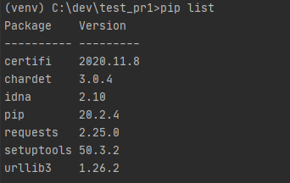
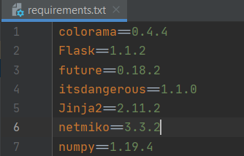
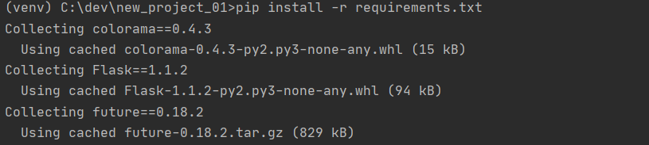
Installing packages with PIP
Pip comes with python by default – package installed (similar to npm in NodeJS)
If you work in a terminal session use pip install <package-name> - this will download and install package, so you can import it in Python code
Pip not only installs requested package, but also its dependencies
As you can recall from last sessions libraries are stored in lib folder in venv
Useful pip commands:
pip list – get current packages installed in your system or venv ------------>
pip freeze > requirements.txt - get a ‘snapshot’ or currently installed packaged ----------->
and save to a file, so you (or someone else) can import
packages in bulk
pip install -r requirements.txt -
install all packages listed in the file --------->
pip without any arguments shows
available options (help)

Slide 5
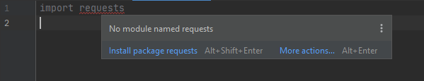
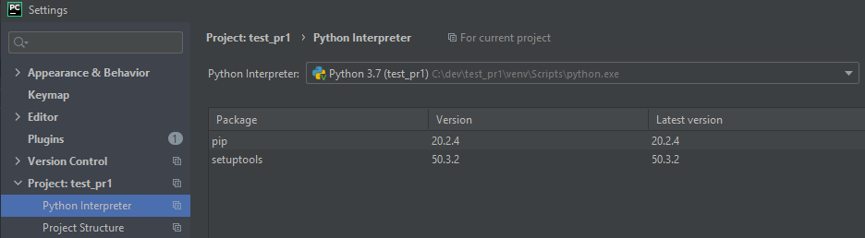
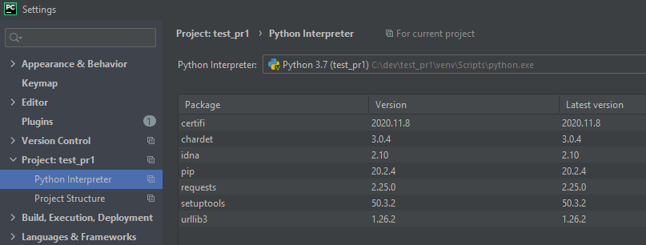
Installing packages using IDE
IDE can recognize many packages
Can install from the main window
where you write code
When you work in IDE and type
module name it will ask you to install it
Uses pip
You can check and install packages manually in the project settings
Before (no dependencies): After (note dependencies are installed):
Notes:
So to sum up, you install libraries in your system and then import them in your code.

Slide 6
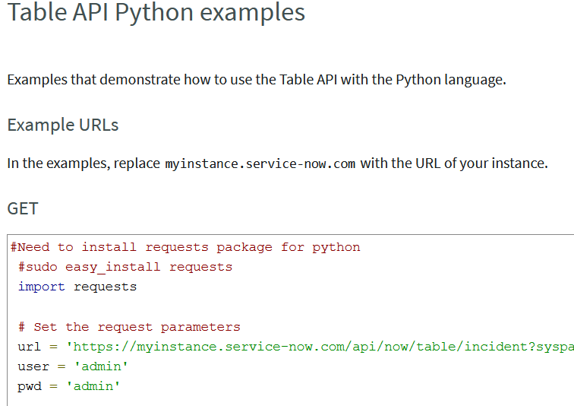
Requests library
The most popular library to make API calls with Python
Vendors provide examples mostly using this library ---->
Easy to use
Offers synchronous (or blocking) API requests – there are also asynchronous libraries, can make multiple request at the same time - more scalable, but more complex - just FYI https://realpython.com/async-io-python/
Excellent documentation https://requests.readthedocs.io
Install it with pip or in IDE
Use import requests in you code
If you make requests to private systems which use self-signed or invalid certificates, you can disable certificate warning messages

Slide 7
Remember session 1 - Basic GET requests with cURL ?
Raw output:
curl -v http://worldtimeapi.org/api/ip”
No parameters:
curl -v https://ipwhois.app/json/8.8.8.8 | python -m json.tool
Let’s include parameters:
curl -v https://ipwhois.app/json/8.8.8.8?objects=country,city,timezone | python -m json.tool
Single parameter:
curl https://api.exchangeratesapi.io/latest?base=AUD | python -m json.tool
Multiple parameters:
curl 'https://api.exchangeratesapi.io/latest?base=AUD&symbols=USD’ | python -m json.tool
More complex response: curl "https://endpoints.office.com/endpoints/worldwide?clientrequestid=b10c5ed1-bad1-445f-b386-b919946339a7"
Body in the request: curl -H 'Content-Type: application/json' -d '{"text": "Test message via Webhook"}' https://outlook.office.com/webhook/82e433c98-a978-465f-8254-9d541ee73c/IncomingWebhook/cb6d6416f49aaba3bd5

Slide 8
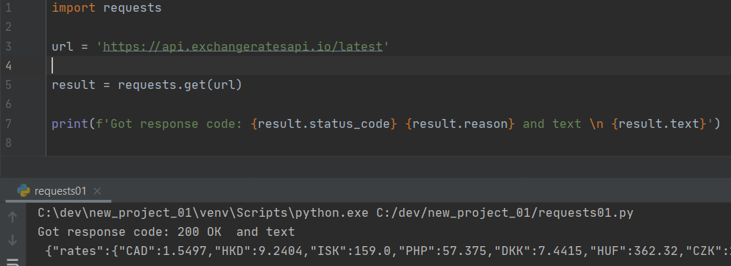
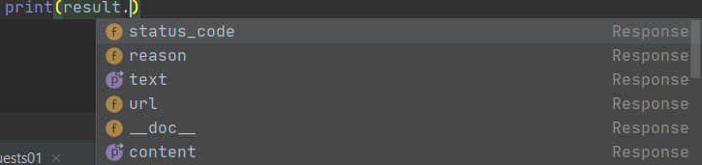
Making API calls using requests library
import requests
Define string variable - url
Make request requests.<method>
like requests.get or requests.post
Remember what we receive from
the server?
Response code
Response body
Headers, cookies, etc…
To access them, we define variable result – what we get from the server we put there
Result is an object – we’ll discuss objects when we learn classes
To access various response object properties, such as content, use <variable_name>-dot-<attibute>
The list of attributes is in the doc, IDE can also help:
result.text – response in text format
result.json () – response in json format
result.status_code, result.reason
Notes:
First we import the library with import statement – line 1, then define a variable, let’s call it URL – line 3, and then we make the API call, line 5

Slide 9
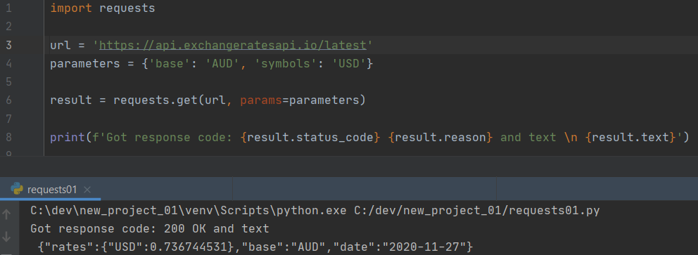
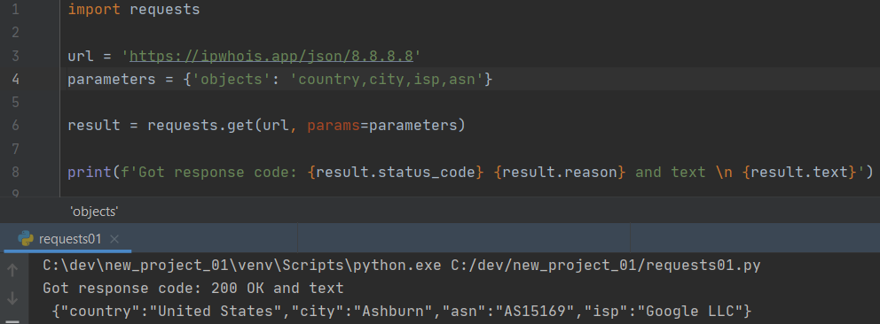
Making API calls using requests library
Adding parameters to the request: https://api.exchangeratesapi.io/latest?base=AUD&symbols=USD
Define dictionary ^^^^^^^^^^^ parameters
key-value pair
where
key is Parameter name
value is Parameter value
Use argument params = <your dictionary>

Slide 10
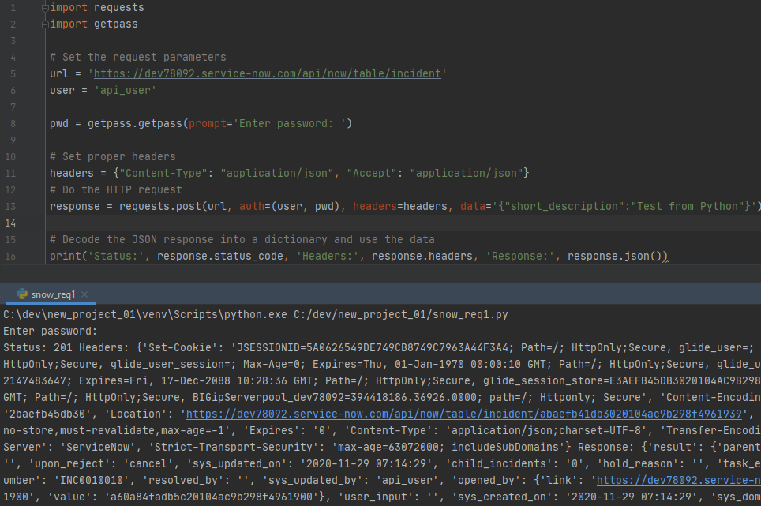
Making API calls using requests library - POST
The example is copy-paste from ServiceNow
The only difference is getpass – line 2 and 8
https://stackoverflow.com/questions/28579468/how-to-use-the-python-getpass-getpass-in-pycharm - getpass requires changing settings in Pycharm
Example of importing a library which you don’t have to install – it’s already included with Python
Note how we can define headers and payload (body) – dictionaries
Use requests.post and specify options:
headers=, auth= method (basic – username and password) and data=
Note we get a whole bunch of text – how to get useful data from it, like Incident number?
Parse JSON
https://docs.servicenow.com/bundle/geneva-servicenow-platform/page/integrate/inbound_rest/reference/r_TableAPIPythonExamples.html

Slide 11
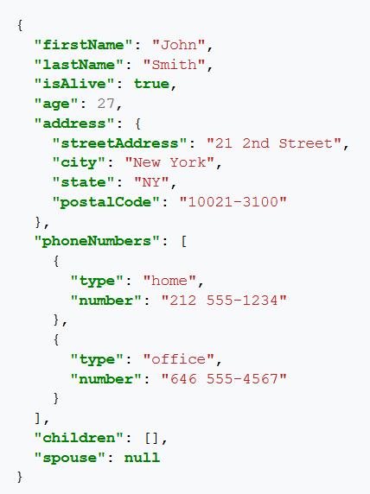
JSON
JavaScript Object Notation
Dataformat. Other dataformats are YAML, CSV, XML, etc.
Used to represent complex data
Used in REST API – de-facto data exchange format
Elements – key : value
Elements are separated with comma
JSON is represented by Python dictionary
Have a look at address element – it’s a dictionary {}
Have a look at phoneNumbers element – it’s a List [] with elements
which are dictionaries
At the end of the day JSON is a string
https://en.wikipedia.org/wiki/JSON
Notes:
.

Slide 12

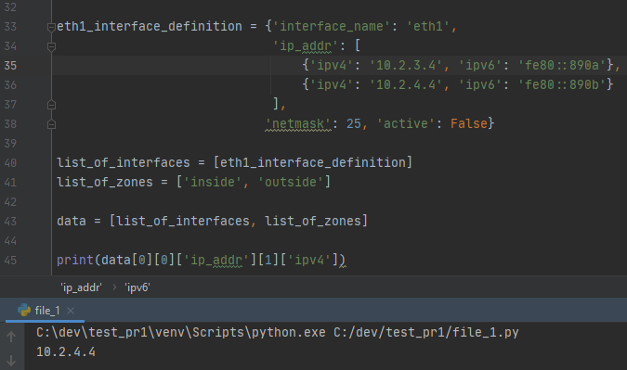
Nested Data Structures – recap from Session3
Remember Lists and Dictionaries?
List of lists where elements are dictionaries and values are lists of dictionaries
data[0][0]['ip_addr'][1]['ipv4’]
How we access them:
data[0] – First element of the list data – we get list_of_interfaces
[0] – Get element of a list with index 0 – the result is dictionary
["ip_addr] – Get value from dictionary using key ip_addr – this gives you another list
[1] – get element from a list with index 1 – this gives you a dictionary
['ipv4’] – get value from dictionary
Notes:
Let’s recall from last session how we access nested data structures.
We need to access IP address of 10.2.4.4 using data variable.

Slide 13

Quiz
What is the difference between these two lines?
What Python data types you can see here?

Slide 14
JSON string vs Python data types
Line 17 is a Python dictionary
Line 18 is a string
There is a big difference between them – we can easily access the element of a dictionary by using the key name, for example:
eth0[‘ipv4’] - will get us result 10.1.2.3
To get the same result from a string eth1, we have to do complex string operations – split the string into multiple pieces and the check each piece until we found the matches what we need.

Slide 15

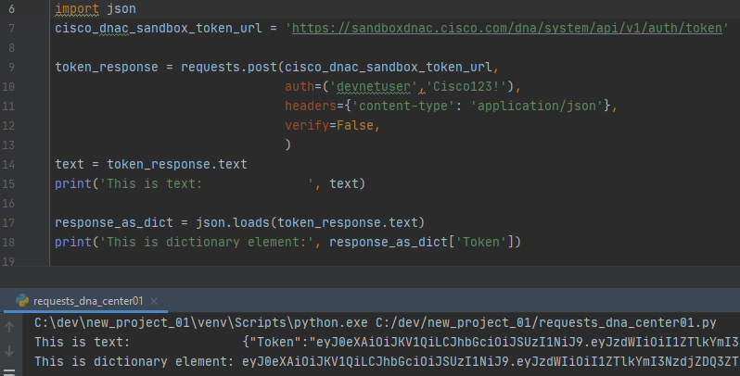
JSON library
The most popular Python library to work with JSON
Standard Python library, so you don’t have to install it
Converts Python data structures into JSON strings and back
JSON string -> Python dict, list json.loads
Python dict, list -> JSON string json.dumps
This conversion allows to access or manipulate JSON data
Steps:
Convert JSON string into Python data structures
Access using standard methods for lists and dictionaries
Example of conversion JSON string to dictionary and getting element Token ------------------------------>
JSON library parses the strings, like this
https://github.com/python/cpython/blob/master/Lib/json/decoder.py
https://realpython.com/python-json/

Slide 16
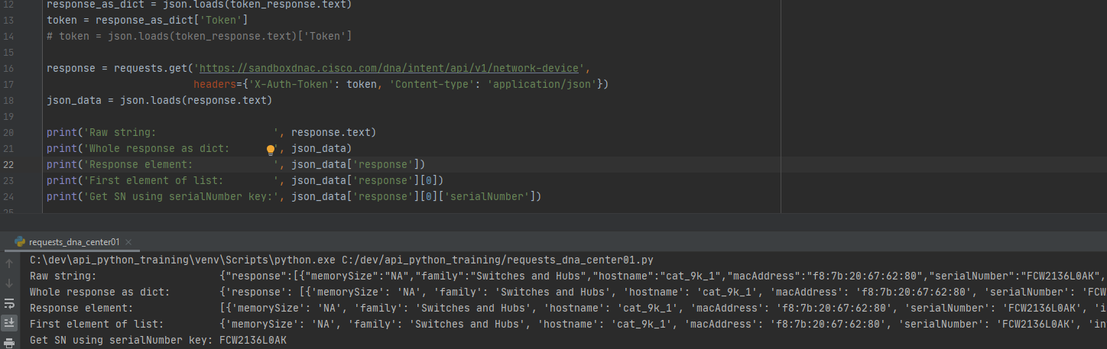
Parsing JSON data
We send a GET request and received some data – it’s JSON string, we convert it into Python data types
In the response we get {"response":[{"memorySize":"NA",serialNumber":"FCW2136L0AK",….etc - how to get Serial number?
1 .Notice {"response": - it means it is a dictionary, so we can use key response
2. Notice {"response":[- it means the value is a list, so we need to use indexes, like 0
3. Notice {"response":[{- it means it is a dictionary again, and we use key value serialNumber
Final result - json_data['response'][0]['serialNumber']

Slide 17
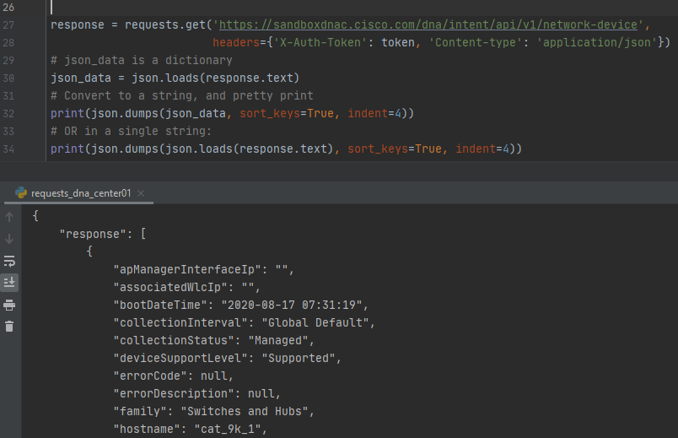
Converting JSON data back to string
In API requests you send JSON as a string, not Python dicts/lists, so need to convert complex data types into string
This procedure is called serialization
Usage - json.dumps(some_dictionary)
Very useful for pretty printing responses
Note there is command json.dump
and json.load without s
used to read/write JSON into a file
As usual, check the documentation for full
list of commands
Pretty printing JSON response
https://www.geeksforgeeks.org/python-difference-between-json-dump-and-json-dumps/

Slide 18
Demo

Slide 19
Summary and next steps
Summary
Python – installing libraries, request library, JSON library, made API calls
Homework
Try different API calls, access JSON data in responses
https://docs.servicenow.com/bundle/geneva-servicenow-platform/page/integrate/inbound_rest/reference/r_TableAPIPythonExamples.html
Try different requests from session 1 and 2 – add parameters, headers, authorization information
Next time
Python control structures – if, for, while
Handling exceptions
Functions

